Slide 1
The Internet of Everything
Digitization Will Change the World
Ned Cabot
Country Digitization, Americas
Office of the Executive Chairman

Slide 2
Digitization

Slide 3
Digitization is the most dramatic technology innovation since the Internet

Slide 4
You have probably interacted with the digitized world today
Notes:
You’ve just not thought about it that way. You’re probably not connecting the dots and not seeing

Slide 5
Digitization will thoroughly transform public safety
Notes:
You will laugh as you train your successor when you tell her how you used to do it in the old days.

Slide 6


My journey to understanding the Internet of Everything:
“From nonsense to knockout”
Notes:
Those are some pretty sobering statistics. And let me be clear – I have nothing but the highest respect for public servants of all kinds – firemen, police, doctors, teachers. So this is not to assign blame. I think the problems are systemic, so no one is really at fault. But at the same time, I think we are reaching a tipping point where we cannot sustain just doing the same thing over and over and hoping things will improve. As a society, I think we all have a responsibility to look at these big, systemic problems.
<CLICK>
Let’s start that journey by looking at two possible futures.

Slide 7
Digitization is the most dramatic technology innovation since the Internet

Slide 8
IoT Is Here Now – and Growing!
50
50
Billion
“Smart Objects”
40
Rapid Adoption
Rate of Digital Infrastructure:
5X Faster Than
Electricity and Telephony
30
BILLIONS OF DEVICES
20
25
Inflection
Point
12.5
10
World Population
6.8
7.2
7.6
0
TIMELINE
2010
2015
2020
Source: Cisco IBSG, 2011
Notes:
Sometime between 2009 and 2010, there was a point of inflexion, where the number of connected devices began outnumbering the planet’s human population. And these aren’t just laptops, mobile phones, and tablets – they also include sensors and everyday objects that were previously unconnected … so IoT exists today in a very real way! More importantly, the gap is expected to widen exponentially over the next several years – with the number of sensors, objects, and other “things” exceeding 50 billion by the year 2020!
Adding all of these physical objects to IP networks imposes new and novel requirements on existing networking models. IT will need to deal with those requirements in relatively short order.

Slide 9
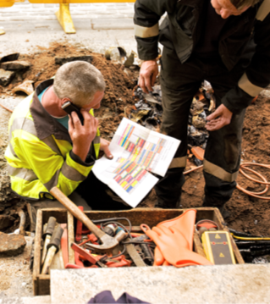

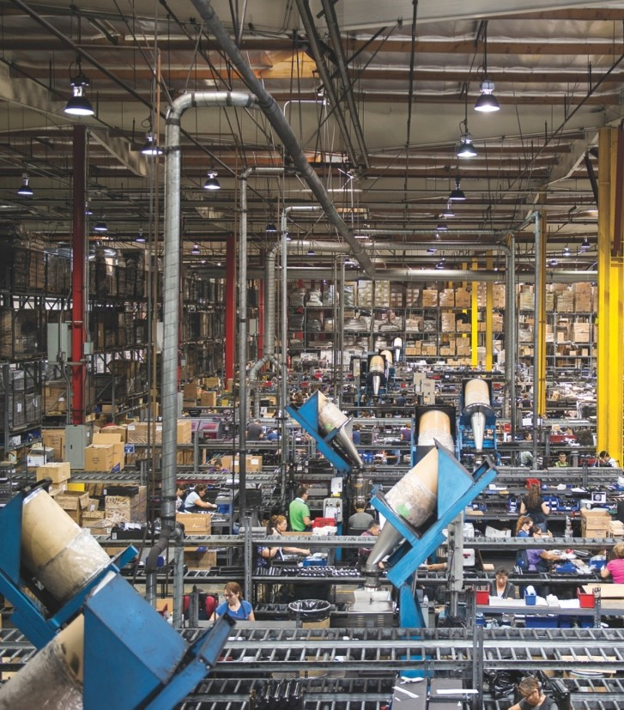
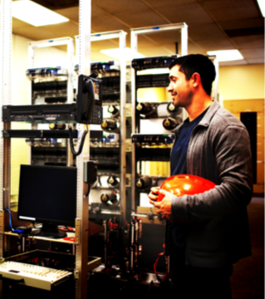


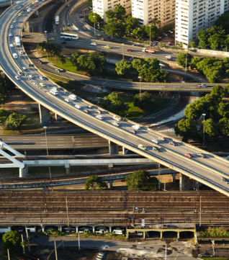


PROCESS MANUFACTURING: Proactive maintenance and safety/security in remote operations, logistics
TRANSPORTATION + LOGISTICS: Maintenance and fleet tracking and new customer experiences
DISCRETE MANUFACTURING: Comprehensive security, better asset utilization, faster reaction times
UTILITIES: Grid modernization and workforce optimization
The Internet of Things
GOVERNMENT/DEFENSE: Response to security threats, natural disasters, secure operations and safety
HEALTHCARE: Patient monitoring, tracking equipment
RETAIL: Secure operations, new customer experiences
AUTOMOTIVE: Driver safety and decision making
Notes:
Update manufacturing bullet point
Real-time mutiple source data access across multiple agencies

Slide 10
Worldwide Connected Device Growth
14.2bn in 2014 to 24.4bn by 2019
Billions of Devices
* Figures (n) refer to 2014, 2019 device share
Source: Cisco VNI Global IP Traffic Forecast, 2014–2019
Notes:
Other data points --- devices per capita.... 2.0 to 3.2...
This could be bigger than the internet – the internet was just about devices that connect people.

Slide 11

How Big Is the Potential Market?
“Trying to determine the market size for the Internet of Things is like trying to calculate the market for plastics, circa 1940. At that time, it was difficult to imagine that plastics could be in everything.”
Prof. Michael Nelson
Georgetown University
Notes:
So how big of a part will IoT play in our lives? Honestly, it’s hard to say …

Slide 12
You have probably interacted with the digitized world today
Notes:
You’ve just not thought about it that way. You’re probably not connecting the dots and not seeing

Slide 13








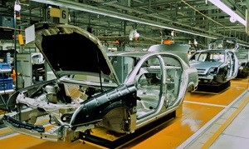




Exponential Innovation
Bookstore
Taxi
Music
Hotel
Print
Advertising
Car
Point-of-Sale
Hotel
Print Advertising
Car
Payment / Point-of-Sale
Notes:
Imagine a smarter city
Speaker Notes Need to be added

Slide 14
You are not Immune!

Slide 15
Economic Challenges & Opportunities
Every
City, Country,
Company, Industry
DIGITAL
Innovation Speed: 2x → X²
Clouds: Private, Hybrid, Public, Fog
Cybersecurity
Global & Mobile
Big Data & Analytics
New Business Models
Digitization: 5-10x the impact of the Internet now.
Notes:
Imagine a smarter city
Speaker Notes Need to be added

Slide 16
Digitization will thoroughly transform public safety
…and more
Notes:
You will laugh as you train your successor when you tell her how you used to do it in the old days.

Slide 17


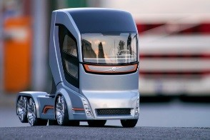



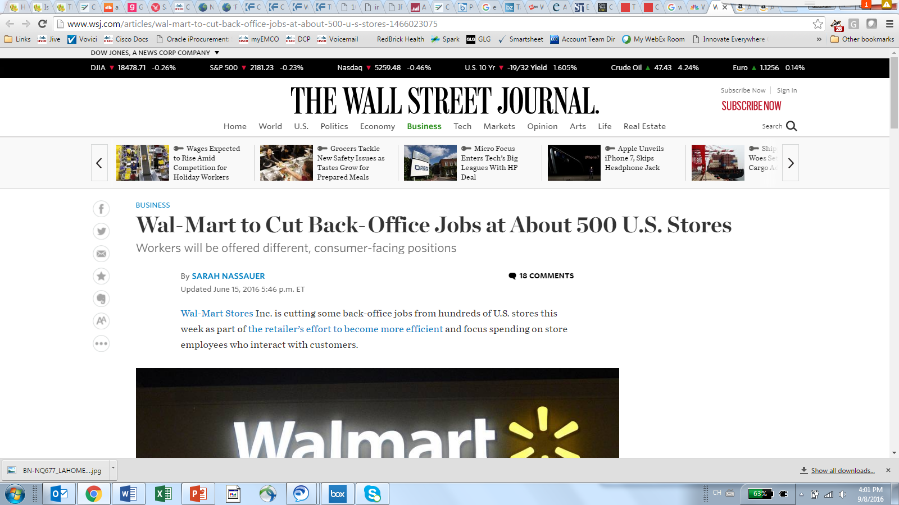

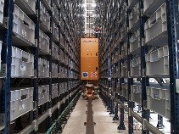





Digital Disruption has Major Implications for the Public Sector
Digitization and job creation
Reduced tax revenue
Privacy, liability
Citizen expectations for how to engage with government
Regulatory complexity in an era of accelerated change
Security, transparency, and trust
Q.
What areas of your jurisdiction are witnessing disruption?
Are there impacts in terms of revenues? Talent? Citizen engagement? Are businesses fleeing (or coming)?
Notes:
Accelerated change, transparency, new business models, higher accuracy of information for high-value transactions (banking, insurance, healthcare).
The public sector moves slowly, but digitization is fast. Not taking action has enormous ramifications on a jurisdiction: evaporating tax bases, security breaches, a talent deficit amongst civil servants, and loss of public trust.

Slide 18
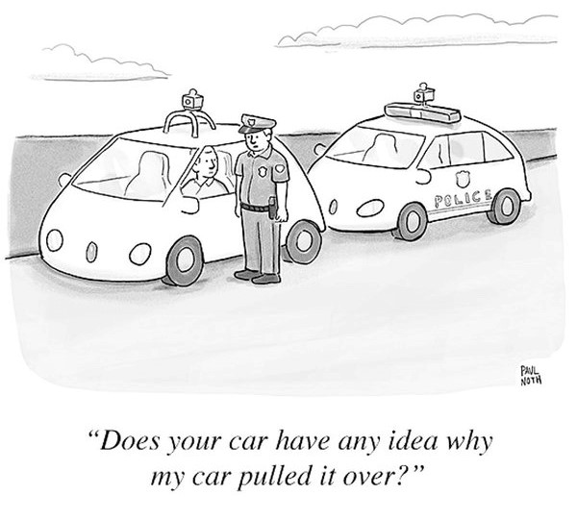
Q.
Which Public Sector Agencies Will Autonomous Cars Disrupt?

Slide 19

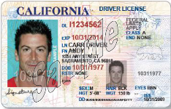
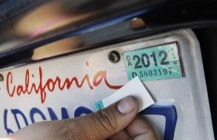
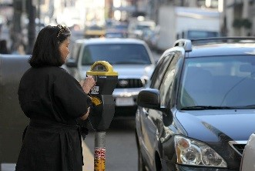
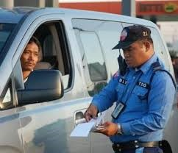
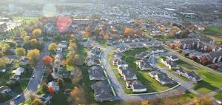
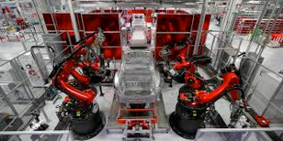



Ripple Effects Across Agencies…
New Car Taxation
DMV Licensing
Car Registration
Parking Metering
Traffic Enforcement
Urban Planning
Auto Regulations
Road Infrastructure
IoT Infrastructure
Public Safety
Notes:
How can governments create policy to transition from the traditional car ownership model?

Slide 20






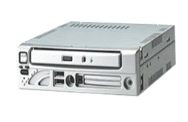



Connected Public Safety Vehicles
GPS
License Plate Recognition
Video Cameras
3G / 4G Backhaul
Laptop or MDT
4.9,5.8, 2.4 GHz Uplink to Mesh or WLAN Infrastructure
900 Mhz/5.9 Ghz TSP
DVR
Wireless VoIP Handset
Printer
PDA
OCR

Slide 21
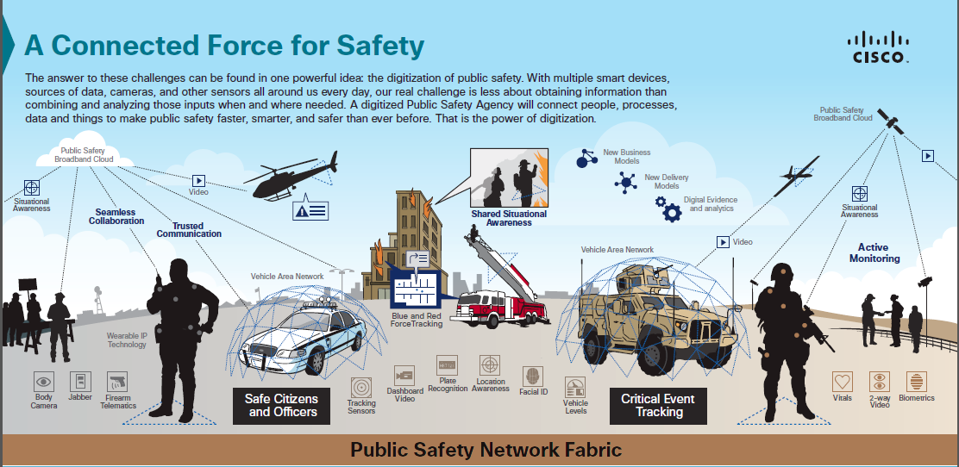

Slide 22
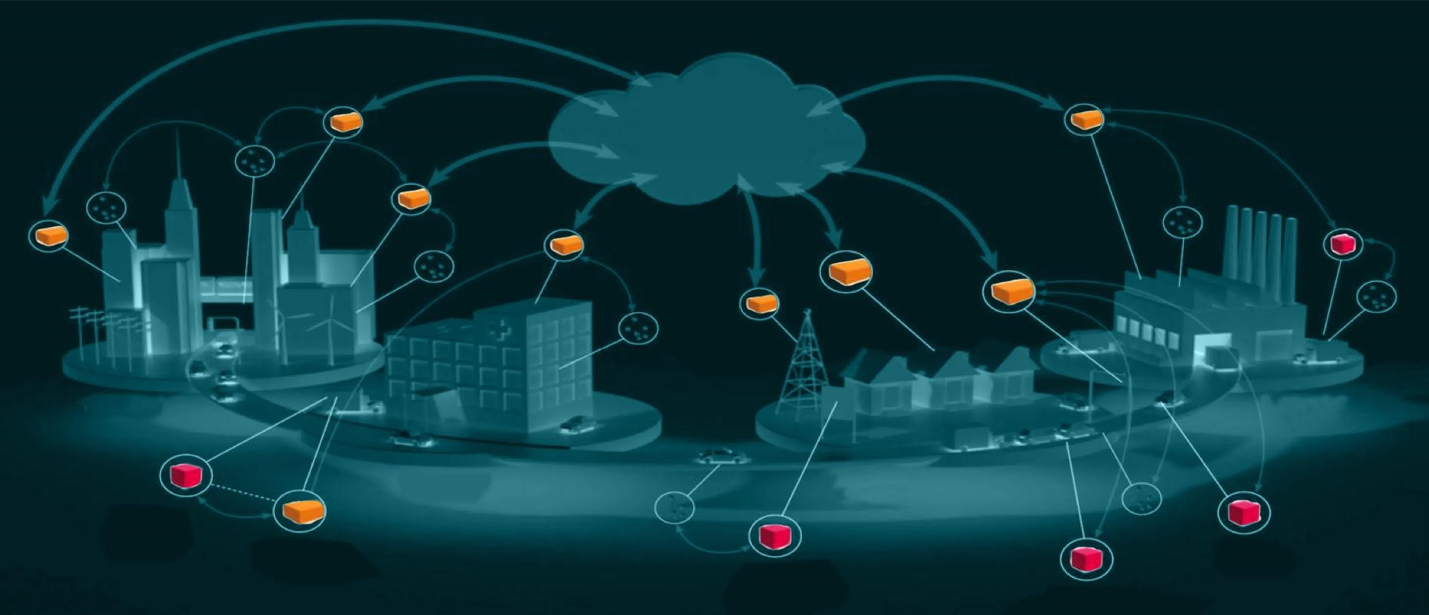
A Digital Overlay for Cities
Municipal Command
& Control Center
Factory
Optimization
Technology Enabled
Services
Smart
Grid
Logistics
Optimization
Home Energy Mgmnt
Lighting
Poles
Building
Optimization
Traffic Flow Optimization
City
WiFi
INTELLIGENT
CITY
INTELLIGENT
Community
INTELLIGENT
Building
INTELLIGENT
HIGHWAY
Traffic
Cameras
Parking
Connected
Ambulances
Automated
Car System
Intelligent Digital
Signage
Source: Intel

Slide 23
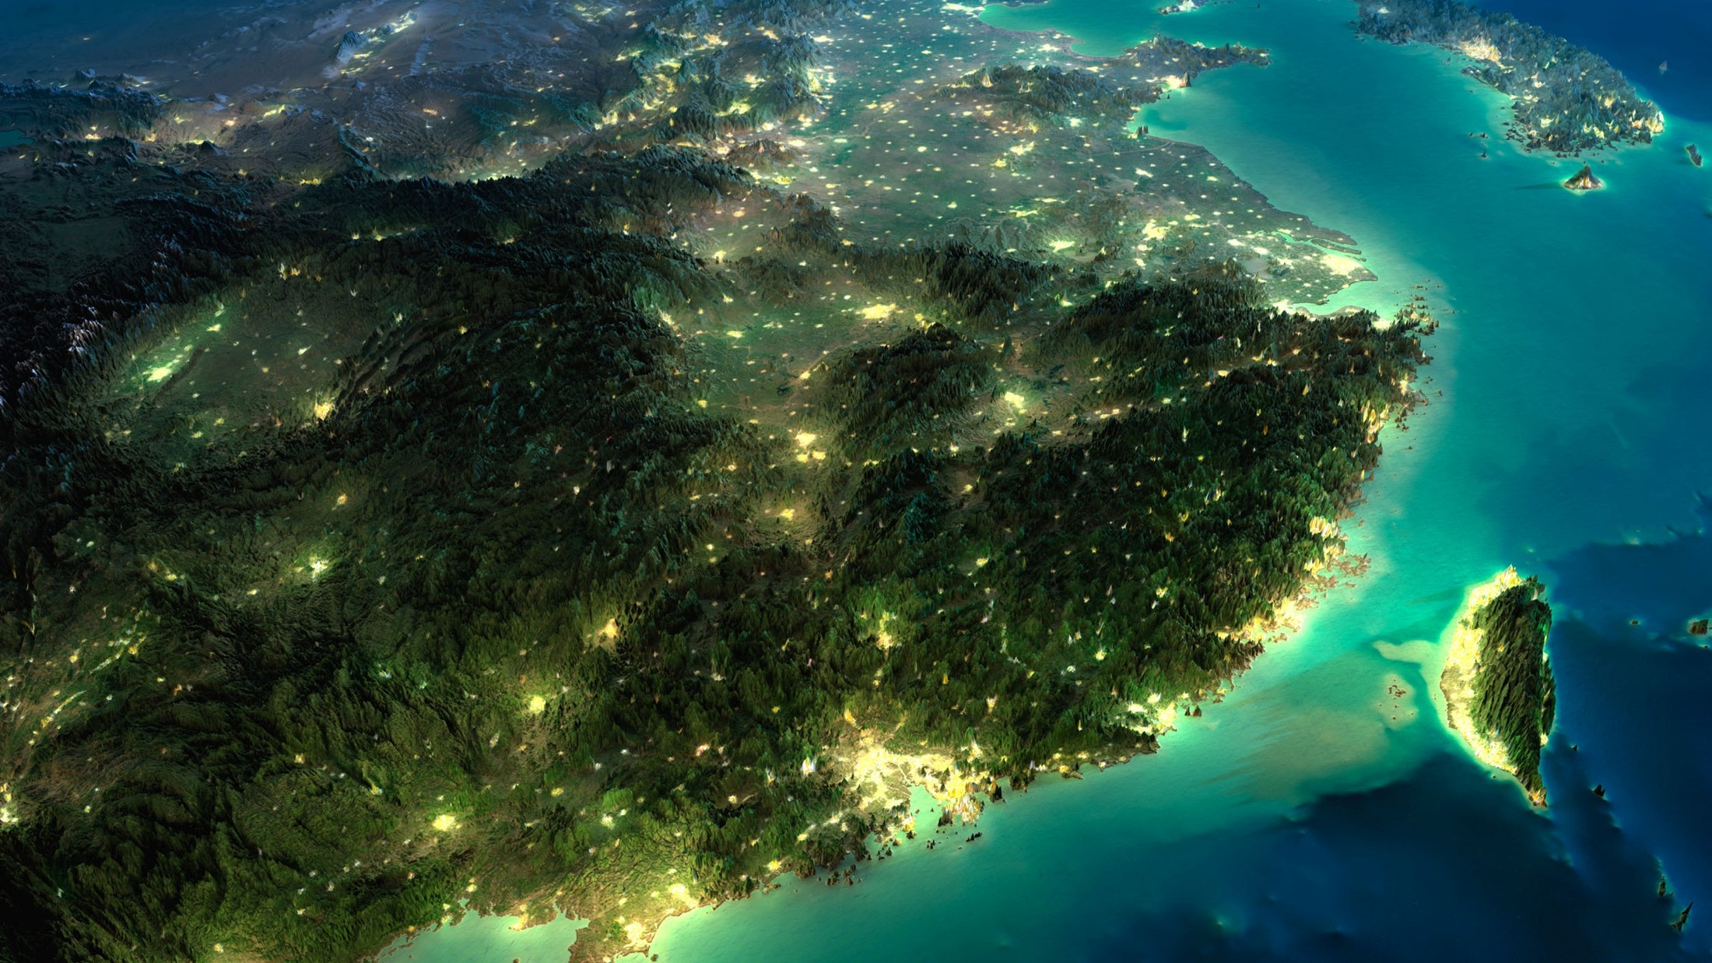
Country Digitization is Improving Citizen Lives
Increase the country’s GDP, accelerate innovation and create jobs
Employment & Social Inclusion
Innovation Opportunities
Public Safety
& Security
Attract Investment
Cyber Security
Smart City Services
Environmental Sustainability
Peace Keeping
Notes:
Cisco defines country digitization as “the process of planning and ultimately building, a sophisticated and forward-thinking IT network ecosystem that will allow for greater connectivity, productivity, and security.”
Private sector and policy makers are expanding their efforts in digitization beyond simply investing in ICT infrastructure. They are recognizing the complex adjacent elements that are needed to create a healthy, thriving digital ecosystem at a national level. The prioritization of programs that focus on developing and strengthening the digital national economy, signals that world leaders are acknowledging the importance of digital culture as a foundational part of economic competitiveness and citizen engagement.
Benefits that result from Countries Digital Transformation include the following but are not limited to:
GDP Growth
Innovation
Employment and Social Inclusion
Public Safety & Security
Smart City services
Environmental Sustainability
Peacekeeping
Cyber Security
Quote
“In a recent interview of Fox Business, John Chambers, Cisco’s Executive Chairman and former CEO, stated that digitization could help increase France’s GDP by 1% to 3% over the next three to five years.”
When evaluating a country’s digital ecosystem, A variety of factors including government policies, ICT infrastructure, the start-up ecosystem, knowledge and IP creation, private sector innovation, and the technology habits of the general population.

Slide 24
THANK YOU
Ned Cabot
Country Digitization, Americas
Office of the Executive Chairman
Tell: 202-222-8368
ncabot@cisco.com
Notes:
Each group can tweak messaging according to their audience.

