Slide 1

MOTOROLA SOLUTIONS
NEXT GENERATION 9-1-1
AND IMPROVED LOCATION ACCURACY SOLUTIONS
2/28/17
DAN SAWICKI, DIRECTOR – NG9-1-1 PRODUCT MANAGEMENT
MOTOROLA SOLUTIONS

Slide 2
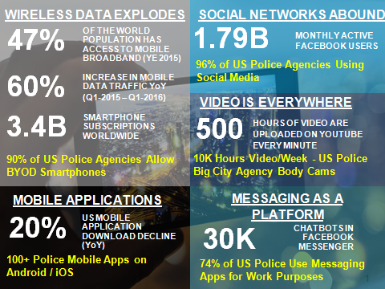
PUBLIC SAFETY TRENDS

Slide 3
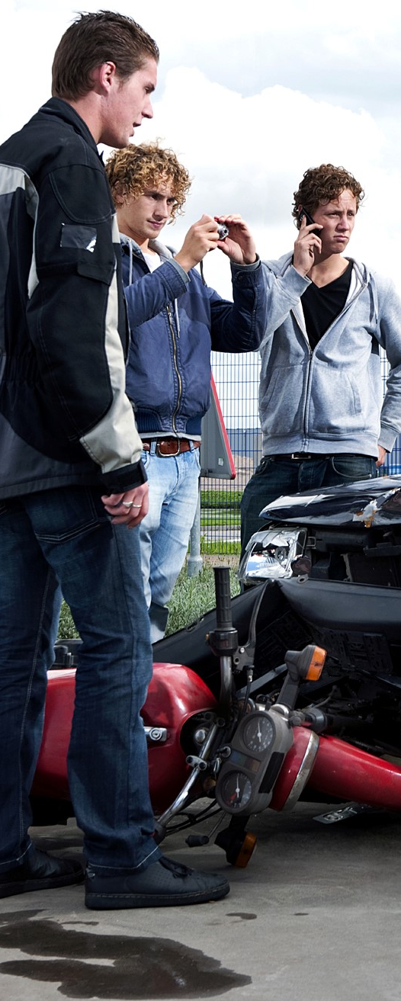
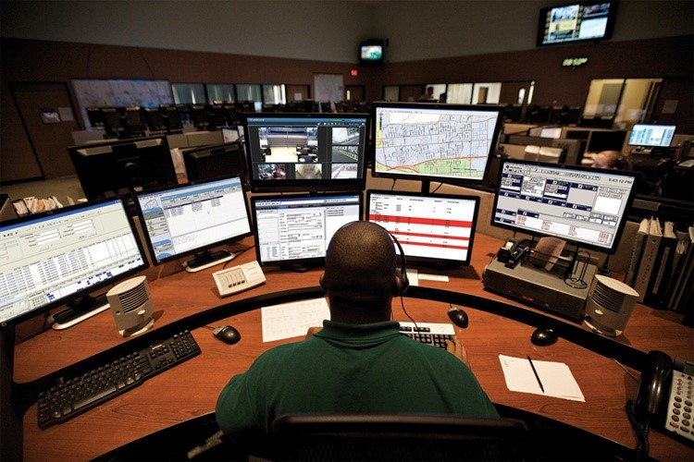
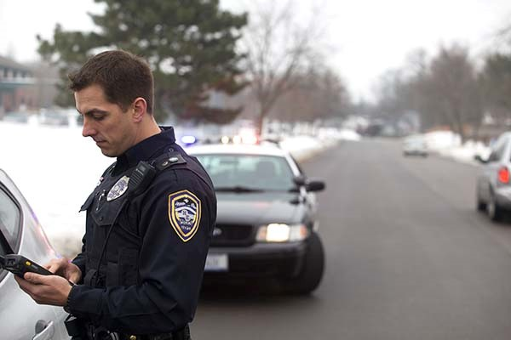
NEXT GENERATION COMMUNICATIONS REALITY

Slide 4
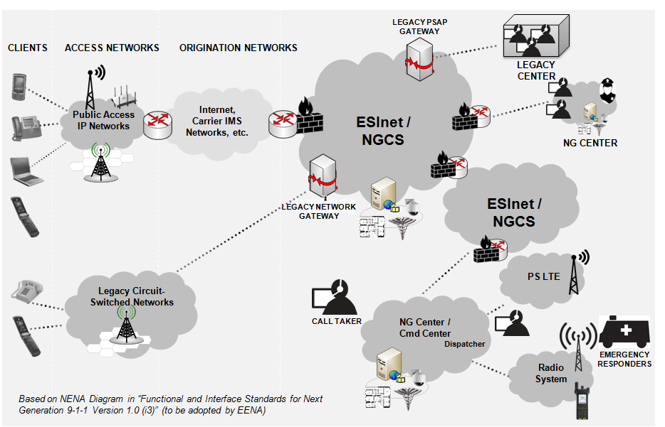
NG - “THE BIG PICTURE”

Slide 5


























USERS/ROLES/WORKFLOW
PUBLIC SAFETY/SERVICE
CUSTOMERS
Citizen
Media
Commercial
Education
First
Responder
911 Call Taker
Dispatcher
Department
Clerk
Detective /
Investigator
Records
Specialist
OPERATIONS
Non-Emergency
Responder
311 Call Taker
Intelligence
Operator
Corrections
Officer
Property &
Evidence Mgr
Supervisor /
Manager
GIS
Manager
IT
Specialist
Systems
Admin
Crime
Analyst
OPERATIONSSUPPORT
Sheriff /
Chief
Command
Staff
Government
Leader
MANAGEMENT/
LEADERSHIP

Slide 6
LOCATION TIE SLIDE WITH RAPIDSOS

Slide 7





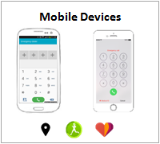
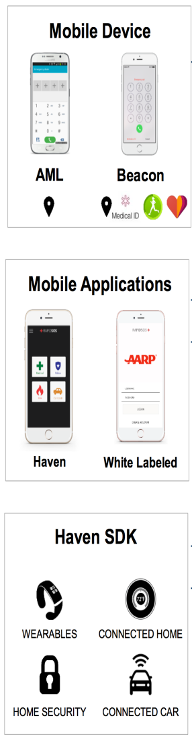


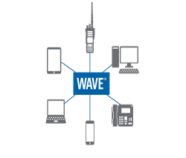
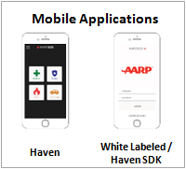



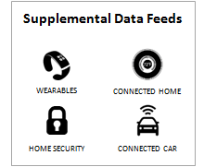









VISIT OUR DEMO TABLE TO LEARN MORE...
Users
Emergency Platforms
Call-Taker/Dispatcher/Analyst
Responders
Precise Location
Supplementary Data
PSAP/Dispatch Center
Response
Analysis
Integrated Command &
Control Center
Emergency
Platform API
Emergency
Platform API
Analytics
API
Analytics API
Intelligence Led Public Safety
Software Development Kit

Slide 8



