Slide 1
Alert Area Cell RF (ARF) Visualization Application
February 28th, 2017

Slide 2
Comtech’s Involvement with U.S. Wireless Emergency Alerts (WEA)
Comtech is a trusted supplier to FEMA for emergency disaster recovery programs, including the WEA.
CMSP gateway (hosted) provider with multiple mobile carriers connected to the WEA platform for nationwide alerting.
Multiple mobile carriers’ in-network deployments.
Extensive experience in on-boarding mobile carriers on the CMSP platform.
Provider of the WARN Gateway system for PBS (Public Broadcast Station).
Highly respected provider for public safety for E9-1-1 and NG9-1-1.

Slide 3
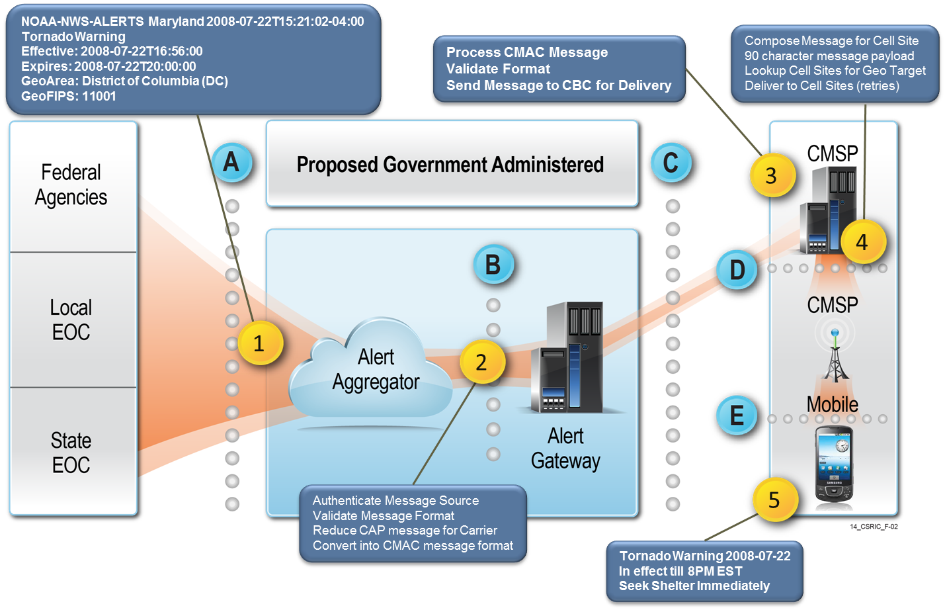
Wireless Emergency Alerts (WEA) Overview
Government Administered
CBC

Slide 4
Background – DHS Research
CMAS (WEA) went live April 2012 with county-level granularity geo-targeting.
WEA stakeholders (DHS, FEMA, NOAA etc. ) recognized the need for better granularity.
The research was conducted under contract with the U.S. Department of Homeland Security Science and Technology Directorate. In November 2013, DHS awarded Comtech a contract to investigate the feasibility of using enhanced geo-targeting algorithms better than minimum requirement.
The project was divided in two phases:
Phase 1 – Evaluated the use of predicted cellular RF coverage areas in geo-targeting algorithm in lab environment, completed in May 2014
Phase 2 – Field Testing in Live Network of Phase 1, completed April 2016
Notes:
Cell Broadcast works during times of network congestion which often occurs during times of disaster.

Slide 5
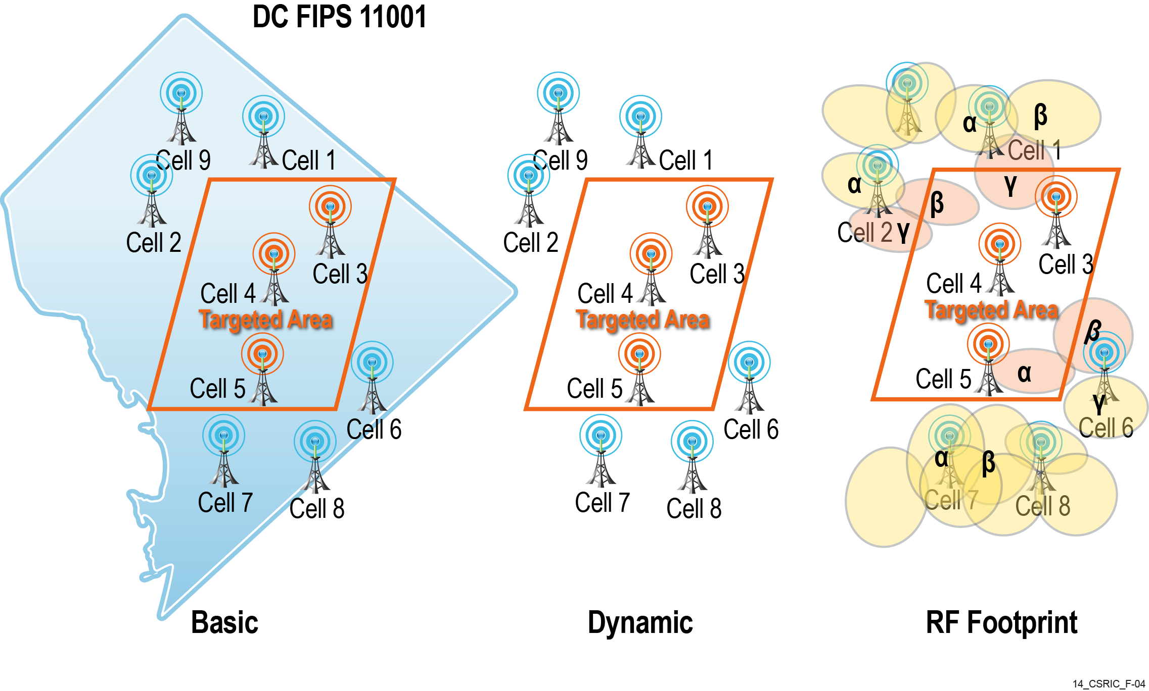
WEA Geo-Targeting Methods Today
Point in Poly
Poly in Poly

Slide 6
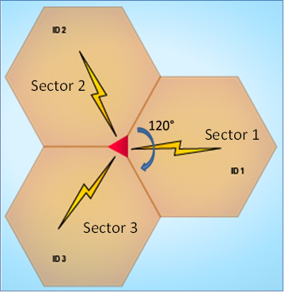
Basic Concepts – Cell Tower vs Cell Sector
Cell Tower
Note: some towers have up to 6 sectors
Notes:
Cell Broadcast works during times of network congestion which often occurs during times of disaster.

Slide 7
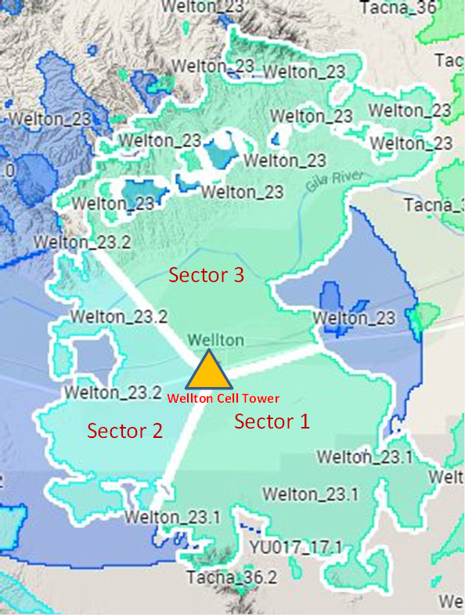
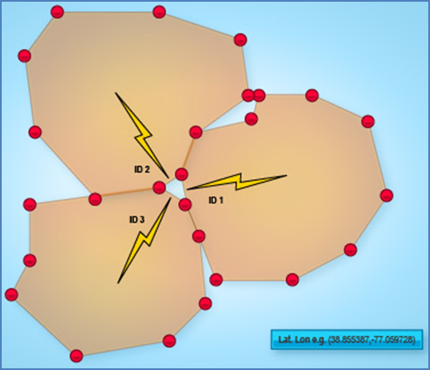
Basic Concepts – RF Propagation Model
Generated By Cell Planning Software
Sets of Polygons with LAT/LON points
Data – Radio characteristics, terrains
Data Set Import into DB for Each Sector
1 Polygon/Sector with many points
Each Tower has 3 Polygons
Notes:
Cell Broadcast works during times of network congestion which often occurs during times of disaster.

Slide 8
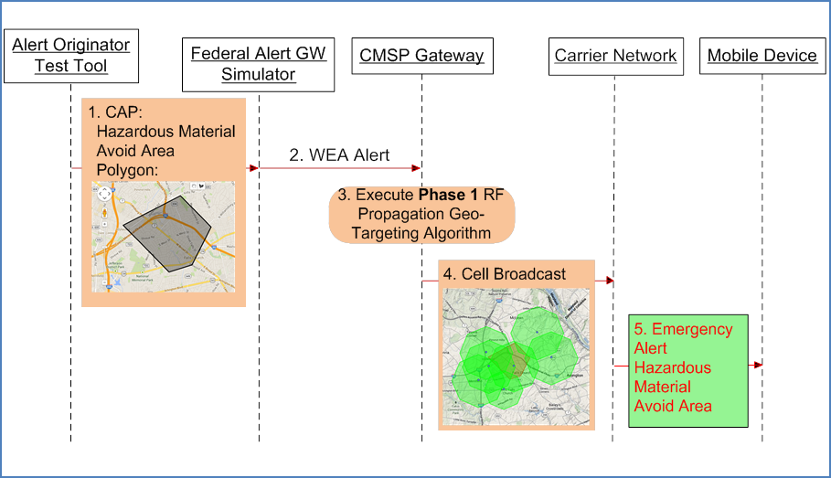
Basic WEA Alert Use Case
Comtech Lab
Live Carrier Environment

Slide 9
Theoretical Expectation - Example
3A
3B
3A
3B
3
3C
3C
1A
1B
1A
1B
1
1C
1C
2B
2C
2B
2C
2
2A
2A
Point-in-Poly Algorithm (Tower Coord.):
Expected outcome:
Cell Broadcast List: All sectors in 1 and 2
Under Alerts: 3B,3C
Over Alerts: 2A, part of 1A,2B,2C
Poly-in-Poly Algorithm (RF Prop):
Expected outcome:
CBC list : 1A,1B,1C, 2B, 2C, 3C, 3B
Under Alerts: None
Over Alerts: Part of 1A, 2B,2C, 3B,3C
Notes:
Cell Broadcast works during times of network congestion which often occurs during times of disaster.

Slide 10
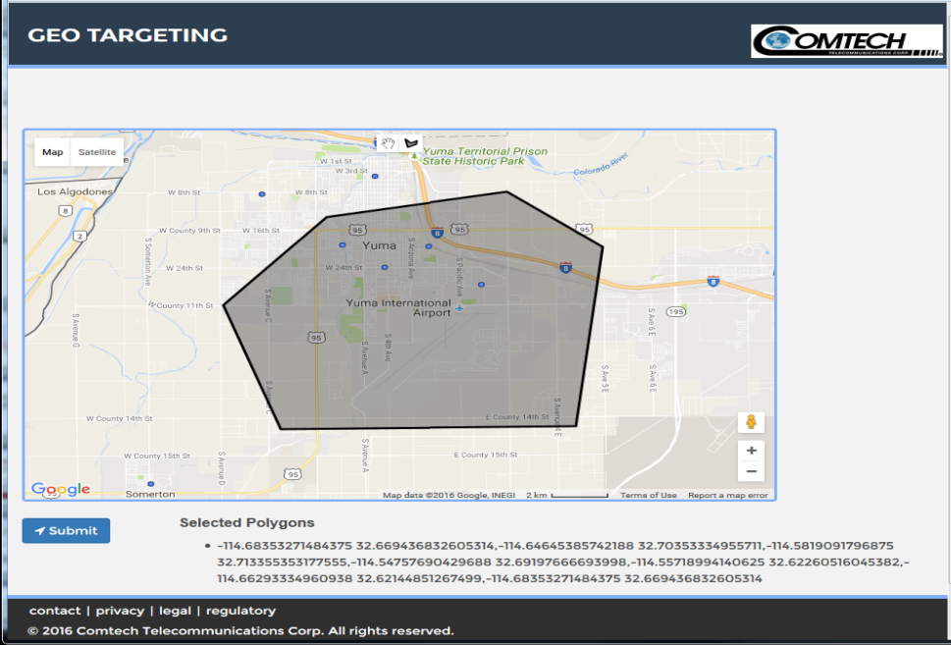
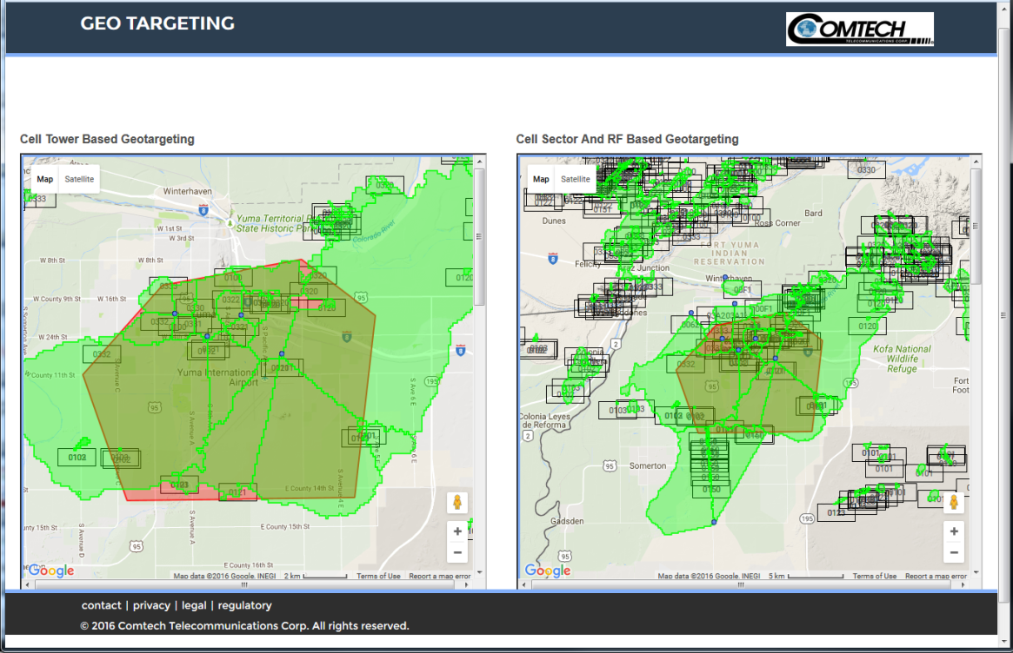
Enhanced Alert Area Definition Tool
The ability to generate an alert target area and show the affected cell sectors RF coverage
Can be used to view RF coverage during cell planning
Draw Target Area
Display Affected Coverage Area
Submit

Slide 11
Geo-Targeting Area Cell RF Coverage Viewer
Notes:
Cell Broadcast works during times of network congestion which often occurs during times of disaster.

Slide 12
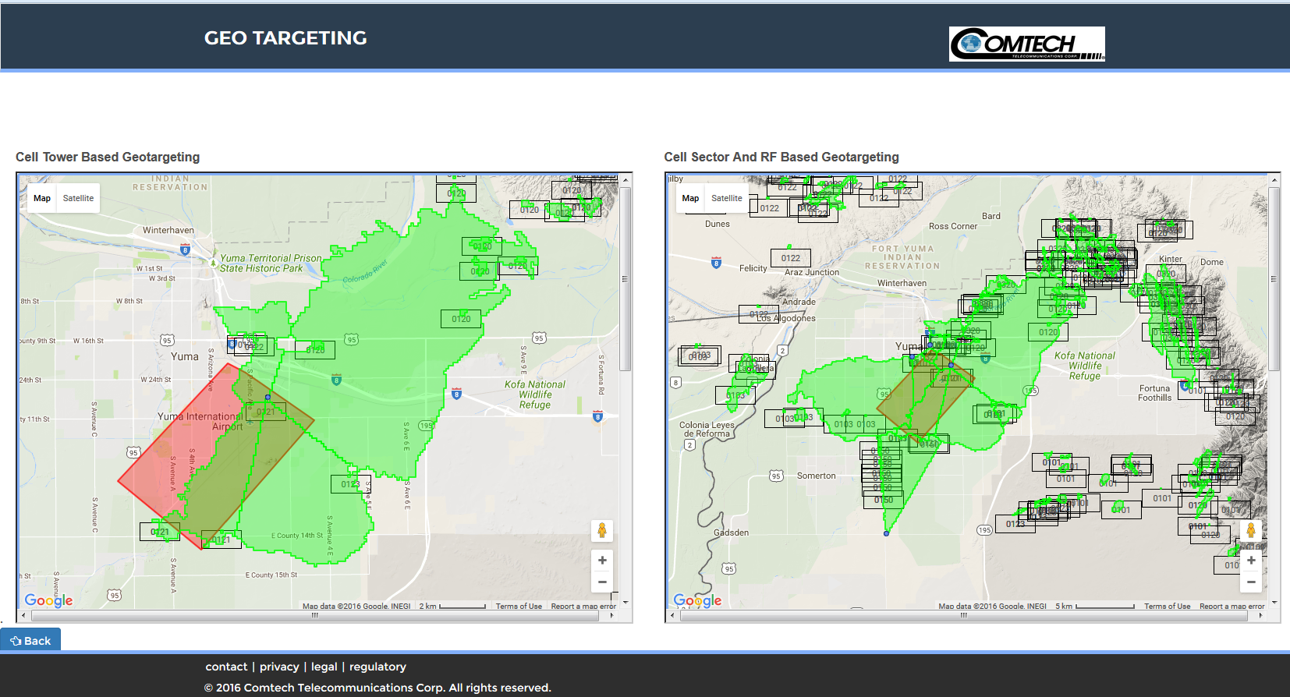
Enhanced Alert Area Definition Tool

Slide 13
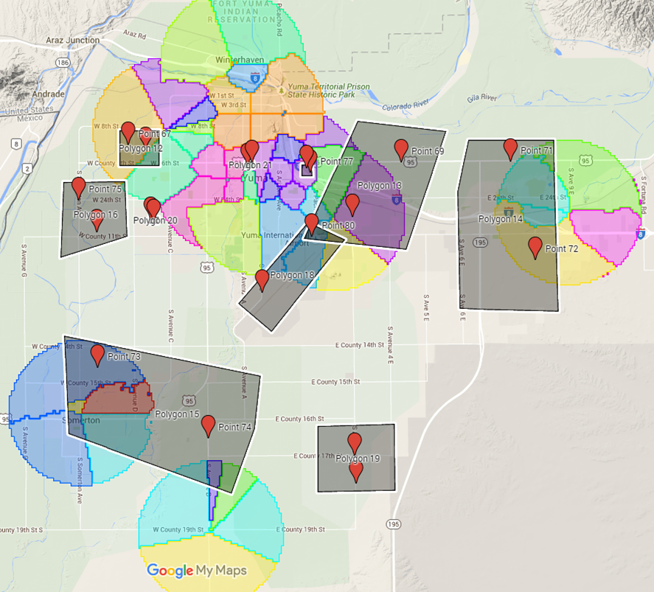
Test Results: Small Target Areas
From 15 sq miles down to 30 acres (1307K ft²)
Elementary School
Hotels
Hospital
Airport

Slide 14
Test Results: Small Target Areas
 | Tower Coord | RF Propagation
Polygon Size Sq Miles (average) | 5.4 | 5.4
Total Number of Success | 2 | 13
Total Number of Over-Alerts | NA | NA
Total Number of Under Alerts (missing alerts) | 16 | 5
Total Number of Test | 18 | 18
Ratio of Success | 11% | 72%

Slide 15
Contact Us
Dara Ung
Systems Engineering, Mobility Solutions
Comtech Telecommunications Corp.
410-280-1214 (o) │ 410-991-9607 (m)
275 West Street
Annapolis, MD 21401
dara.ung@comtechtel.com
@ComtechET
www.comtechtel.com

