Slide 1
NextNav, LLC
High Precision Urban and Indoor Positioning Services

Slide 2
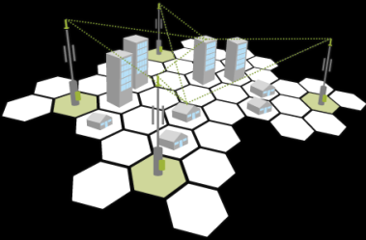
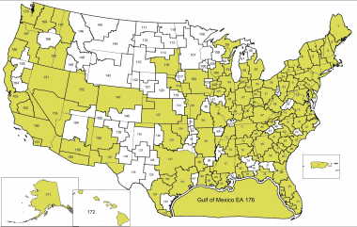

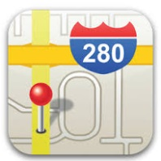
NextNav Overview
NextNav is a network services provider deploying a “terrestrial constellation” to complement GPS in urban and indoor environments
  NextNav network beacons are essentially low-cost terrestrial “satellites” broadcasting from towers and roof-tops
Nationwide spectrum licenses, intellectual property and wide-area architecture provide consistent ‘store level / floor level’ precision across entire metropolitan areas. Exceeds FCC objectives for horizontal and vertical location accuracy.
Service capability designed for ‘Mission Critical’ applications (Public Safety and E911) with battery back-up, redundant systems and internal clocking

Slide 3
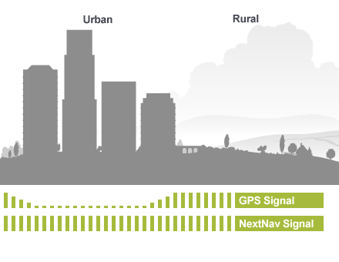
GPS Satellites are Too Far Away for Reliable Urban and Indoor
GPS in Open Sky, Good Performance
GPS Signal Blocked,
No Height Information
GPS satellites are 20,000km away…
…while the NextNav signal is terrestrial.

Slide 4
Emergency Dialing US – (E911)
FCC 4th Report and Order (2015) established requirements for locating wireless callers precisely when they dial “911” from their Mobile phones
  Previous rules only required outdoor callers to be located, new rules include indoor callers as well
  GPS effectively addresses requirement in rural and suburban environments
  Neither GPS (insufficient yield) nor OTDOA (insufficient accuracy) address urban indoor needs
Initial FCC milestone 2Q17 with escalating accuracy requirements through 2Q21
  X-Y accuracy: 40% of calls within 50 meters in 2017, increasing to 80% in 2021
  Z axis (vertical) location: Top 25 Markets by 2021, Top 50 Markets by 2023
CTIA Test Bed (Nov 2016) validated NextNav’s performance exceeding all FCC horizontal and vertical objectives
NextNav partnered with AT&T and VZ in FCC/CTIA Test Bed

Slide 5
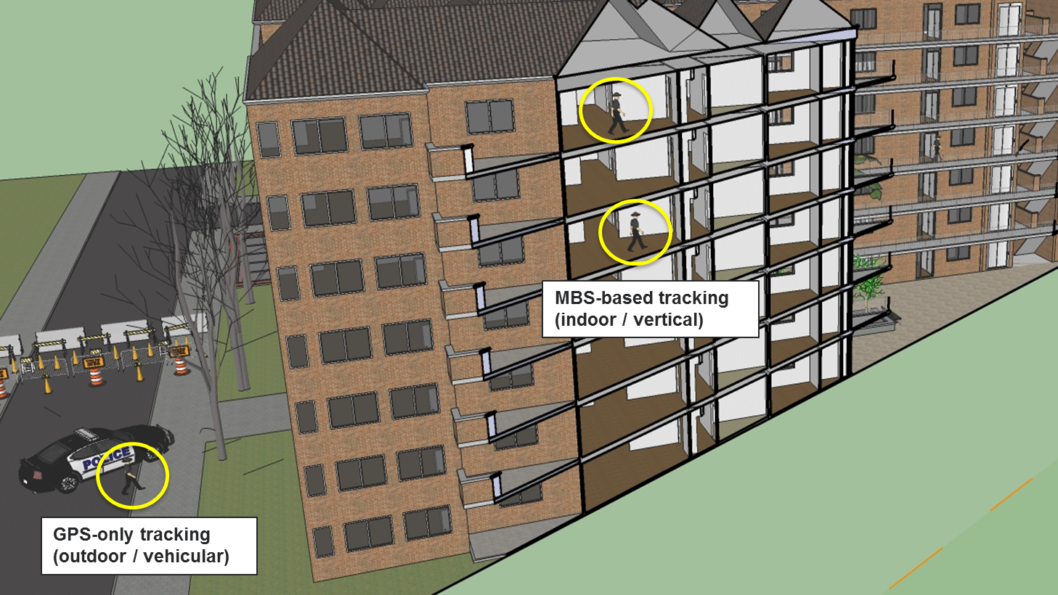
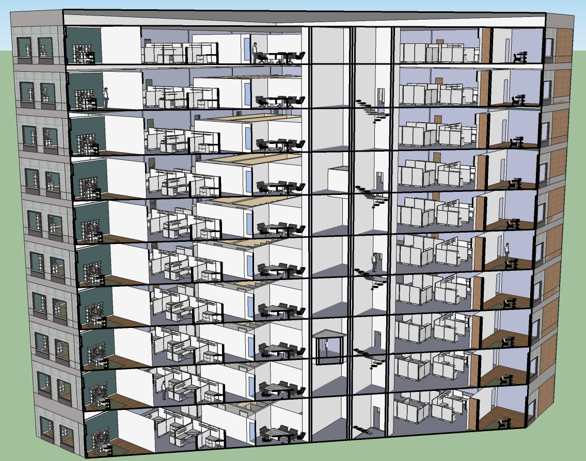
In Emergencies, Vertical Can Be The Difference between Life and Death
FCC/CTIA 4Q16 Test Bed validated NextNav vertical performance
(1.7m accuracy @ 80%, 2.3m @ 90%, and >99% yield)

Slide 6
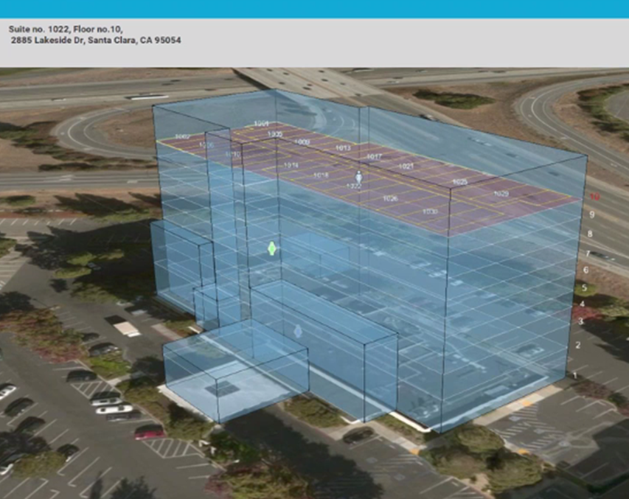
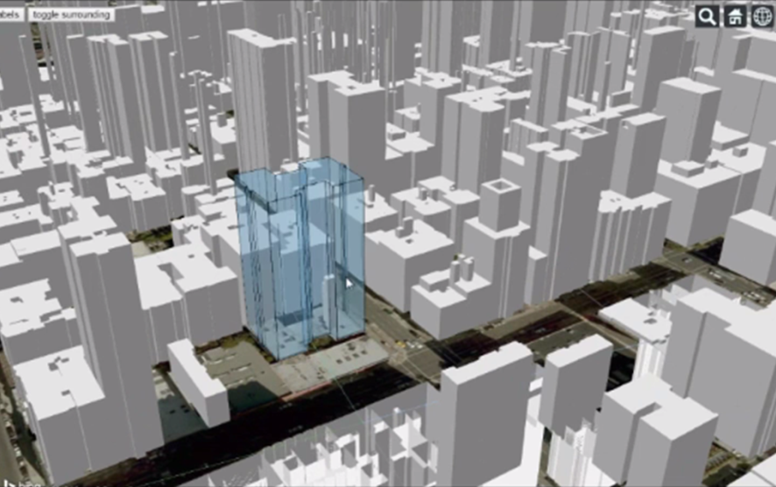
“Blue Force” Tracking and Situational Awareness
Mission Critical Enhanced Location part of FirstNet Objective for IOC 5 (within 48 months of contract award)
NextNav location signal combined with powerful 3D Visualization and Context capabilities
  NextNav software tool integrates multiple data sources and calibrates with location network
  Proprietary techniques determine floor spacing and other building dynamics
  Facilitates rapid 3D mapping of campuses and dense urban areas
  Powerful command and control tool for active shooter, incident management, etc.
3D Position Based on NextNav Network
  Roughly 100 beacons per large city
  User-devices receive signal through compliant GPS chips (3GPP Release 13)
Live demonstrations for numerous First Responder and national security organizations

Slide 7
MBS Capability Demonstration
Reserved for video

