Slide 1
$14M Raised from Preeminent Global Investors
Traditional Venture Capital Funds
Strategic Investors
Individual Investors and Technologists
Multiple prominent technologists and entrepreneurs (including four billionaires) with personal connections to challenge
Top quartile flagship VC fund
World’s largest public safety company
Government
Top quant VC / PE / hedge fund; $25B AUM
VC arm of the world’s largest member organization representing 50M+ Americans and 200M+ people globally*
Several prominent technologists and entrepreneurs with close government ties including two former FCC Chairmen
Technologists
Top municipal west-coast VC founded by Steve Westly (former CFO of State of CA and Ebay exec)
Primary LP & partner for Westly municipal innovation fund
Technology pioneers and entrepreneurs that built and exited multi-billion dollar tech companies
Investors
Leading first responder tech VC fund led by former law enforcement officials
Large integrated oil company –
focused on safety
Multiple prominent global investors / asset managers that have built leading hedge funds and private equity firms representing over $100B in assets
Confidential Summary
February 2017
| Confidential

Slide 2
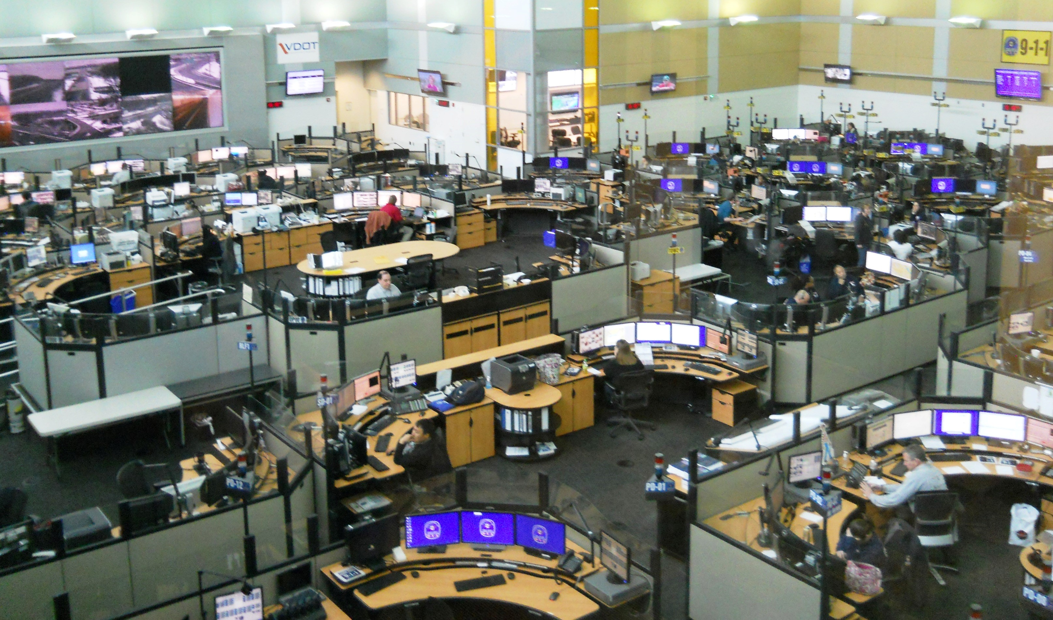
Extraordinary Dedication and Technology
| Confidential

Slide 3
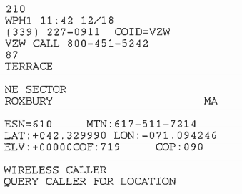
BUT: 240 Million+ 911 Calls Limited to 512 Characters
911 in 2017: 512 Characters
First Trans-Atlantic Telegram (1858): 619 Characters
"The Queen desires to congratulate the President upon the successful completion of this great international work, in which the Queen has taken the deepest interest. The Queen is convinced that the President will join with her in fervently hoping that the electric cable, which now connects Great Britain with the United States, will prove an additional link between the two places whose friendship is founded upon their common interests and reciprocal esteem. The Queen has much pleasure in thus directly communicating with the President, and in renewing to him her best wishes for the prosperity of the United States."
| Confidential

Slide 4
NG911: A Transformative Opportunity
“The good news is we know what to do. The nation’s 911 call centers need to upgrade to “Next Generation 911,” or NG911.
NG911 links 911 call centers to the latest Internet Protocol-based networks, uses mapping databases and software to route calls and pinpoint the real-time location of 911 callers, and supports voice, text, data and video communication.
The bottom line is that NG911 will make our 911 system more accessible and more reliable, and it will dramatically improve emergency response.”
Former Chairman, Tom Wheeler
New York Times OpEd
| Confidential

Slide 5
NG911 Promise & Challenges
| Confidential

Slide 6
RapidSOS: Four Years of Development with Public Safety
(the slowest tech start-up in history)
2,000+ public safety officials
Top public safety thought leaders
NG911 Clearinghouse
Hundreds of agencies
Collaboration with nearly every major vendor
Summary: Standards-based NG911 data clearinghouse – deployable in days
Easy integration: NG911 additional data interface CPE/CAD/map/network
Cost: RapidSOS does not charge
Location: Device-based hybrid location from smart phones (85% of calls less than 50M)
Additional data: PSAP/responding agency can select modules (medical, demographic, multimedia)
Scale: Millions of consumer devices feeding data
Collaboration with major industry associations
Four years of iteration and learning
Demonstration mobile app
Top technology companies
Three dozen leading non-profits
Top researchers on emergency response
Hundreds of thousands of live & test calls
Top technology investors
| Confidential

Slide 7
RapidSOS: Nationwide Standards-Based NG911 Clearinghouse
Rich Emergency Data from Millions of Devices
46 signed partners: smart phone, wearable, vehicle, IoT
NG911 Rich Data Link
Partnerships with most CPE/CAD companies & network operators
Smartphone
NG911 CLEARINGHOUSE
Public Safety Network
Precise location
Type of emergency
Vehicle telematics
Real time health data (vital signs)
Voice
911 Dispatchers
Health Wearables
State or regional ESInet
NG911-enabled CPE/CAD
First responder devices
Secure
Tunnel
Connected Car
Multimedia
Photo
Video
Medical & demographic data
Internet of Things
First Responders
Home Security
Faster Response
More Data
Transformed Outcomes
Dispatchers save up to 5 minutes in response time
512 characters now rich data link
Unprecedented situational awareness transforms emergency response
| Confidential

Slide 8
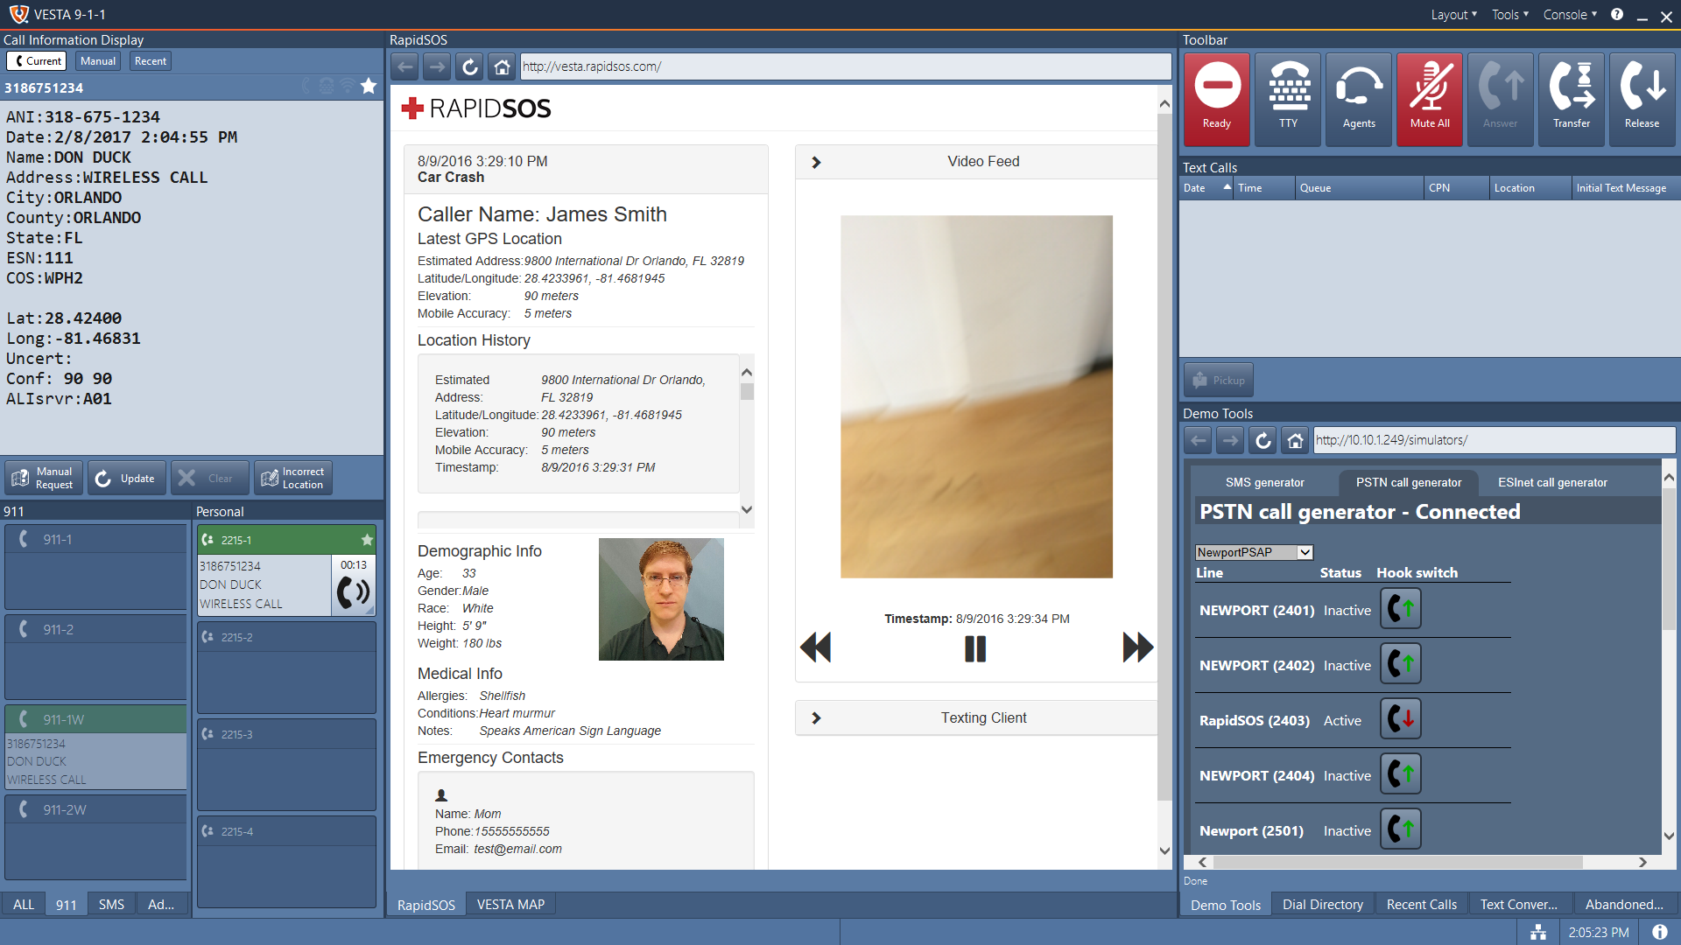
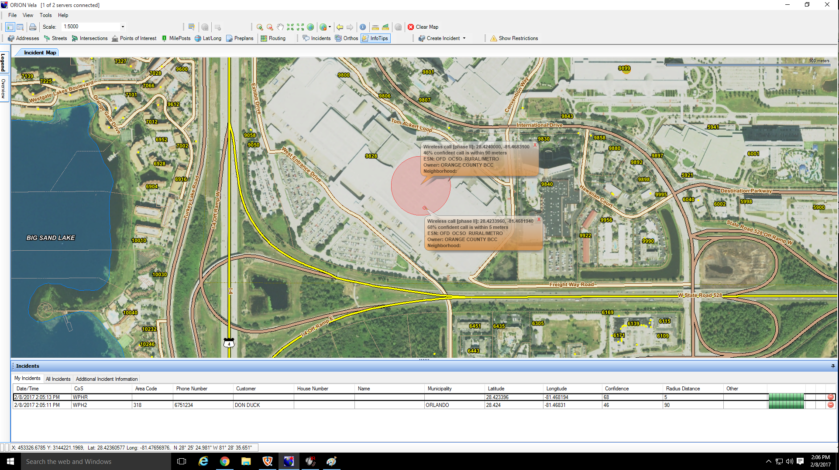
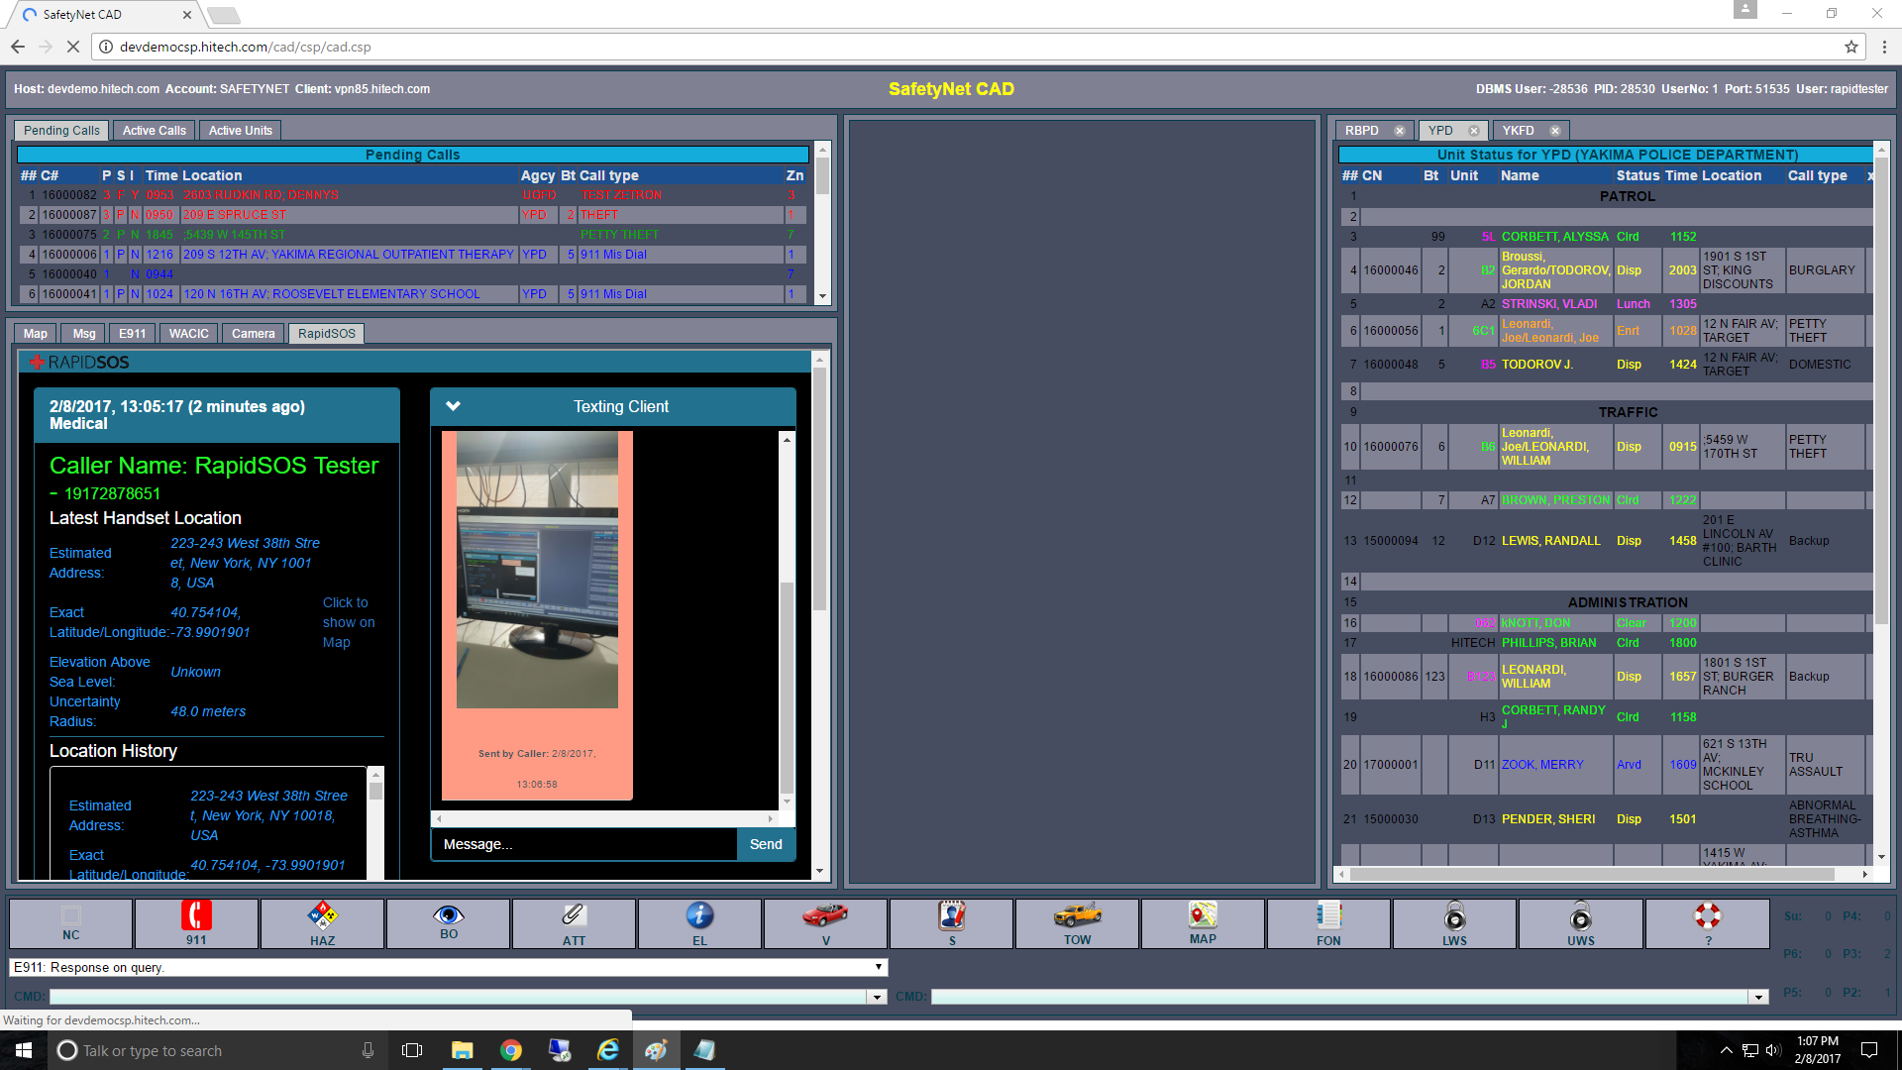
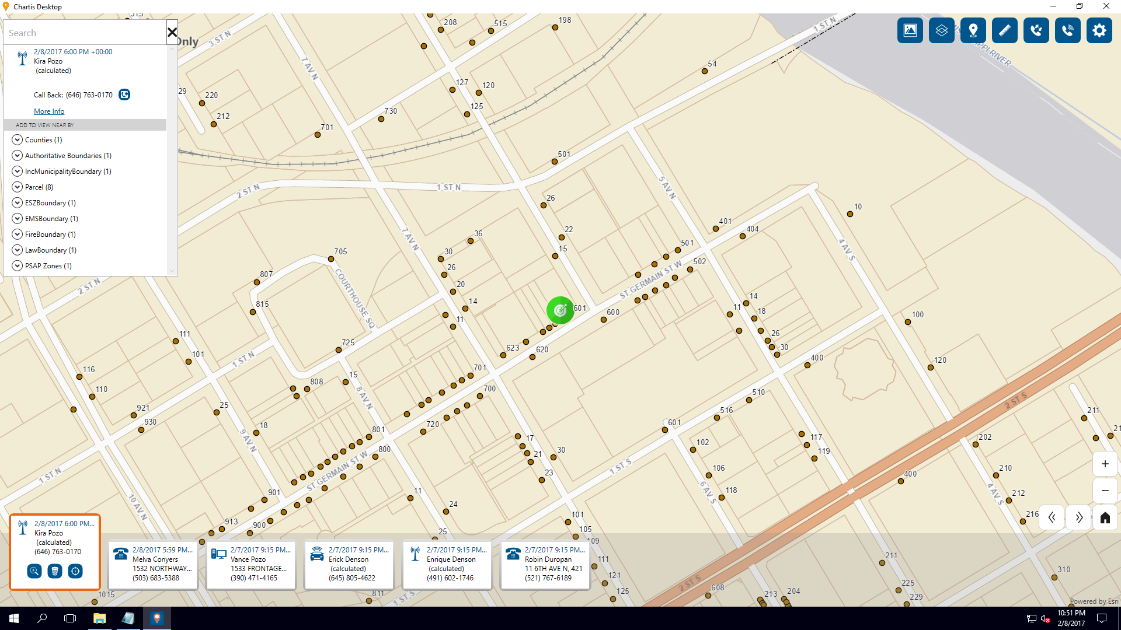
See Demos at Our Table
Standards-based clearinghouse for supplemental data – transforms emergency response
RapidSOS data window pops and device-based hybrid location appears on map
| Confidential

Slide 9
See Demos at Our Table
Standards-based clearinghouse for supplemental data – transforms emergency response
| Confidential

Slide 10
$14M Raised from Preeminent Global Investors
Traditional Venture Capital Funds
Strategic Investors
Individual Investors and Technologists
Multiple prominent technologists and entrepreneurs (including four billionaires) with personal connections to challenge
Top quartile flagship VC fund
World’s largest public safety company
Government
Top quant VC / PE / hedge fund; $25B AUM
VC arm of the world’s largest member organization representing 50M+ Americans and 200M+ people globally*
Several prominent technologists and entrepreneurs with close government ties including two former FCC Chairmen
Technologists
Top municipal west-coast VC founded by Steve Westly (former CFO of State of CA and Ebay exec)
Primary LP & partner for Westly municipal innovation fund
Technology pioneers and entrepreneurs that built and exited multi-billion dollar tech companies
Investors
Leading first responder tech VC fund led by former law enforcement officials
Large integrated oil company –
focused on safety
Multiple prominent global investors / asset managers that have built leading hedge funds and private equity firms representing over $100B in assets
| Confidential

