Slide 1
West’s Safety Services
John Snapp
VP Technology

Slide 2
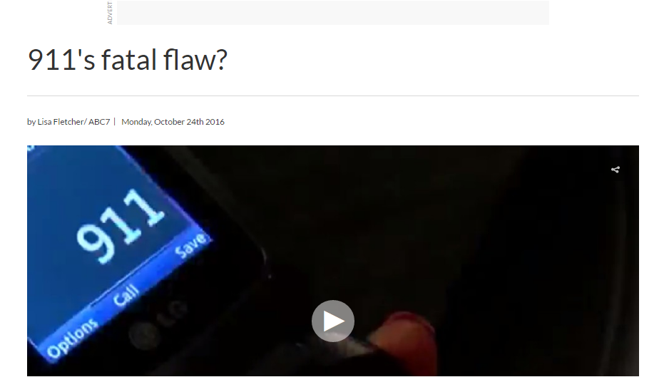
Increasing Media Coverage
Esquire.com
WXIA-TV, Atlanta
USA Today
WJLA, Washington, D.C.

Slide 3
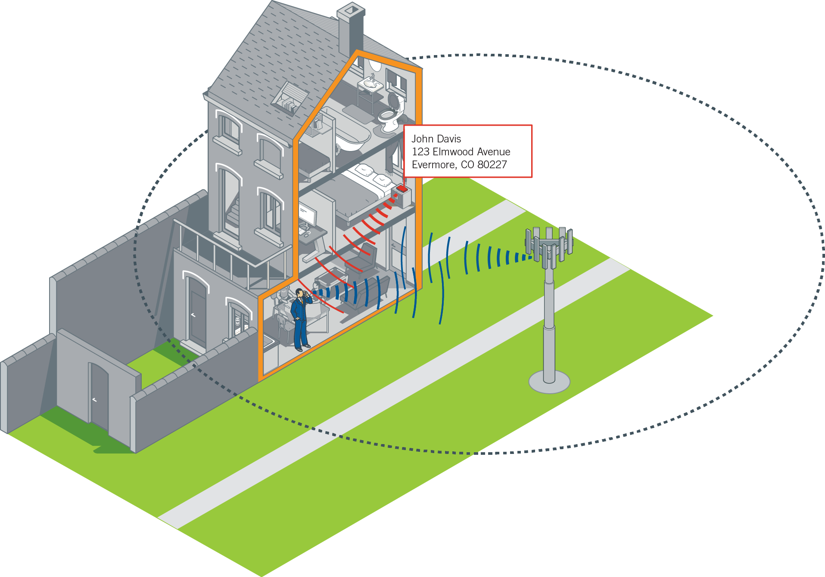
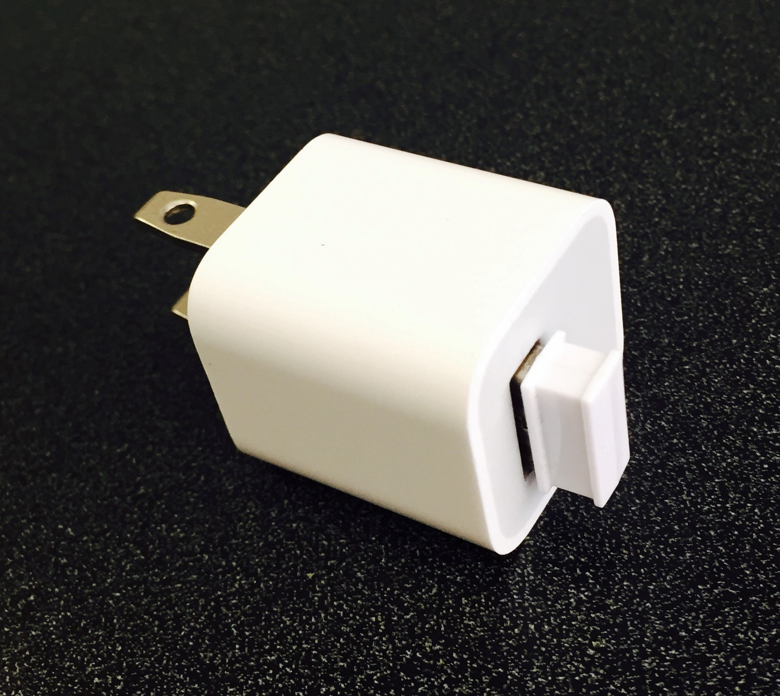
Wifi and BlueTooth (BLE) Beacons
Features
Provisioning and management of Wi-Fi A/Ps and Bluetooth LE beacons addresses
Dedicated 9-1-1 units or shared infrastructure
Physical beacons available*
Benefits
Dedicated 9-1-1 beacons provide highly accurate and manageable dispatchable locations
Ideal for residential applications
Provides wireline level of 9-1-1 accuracy and information for wireless devices
Low cost
Highly accurate
Notes:
WDLS Features (10 min - traditional WDLS)
Breakdown of features
Value
How to sell the story

Slide 4
Questions

